Slide 1
The Future of Diversity and Inclusion in Oak Park
Rob Breymaier,
Oak Park Regional Housing Center

Slide 2
Agenda
Changes from 2000 to 2010 Census
Looking to the Future
The Housing Center’s Role

Slide 3
Our Regional Situation
The Chicago Region is Hyper-Segregated
Consistently Among the Nation’ 5 Most Segregated
Extreme Disparities in Opportunity
Tremendously Disjointed
Institutionally
Personally

Slide 4
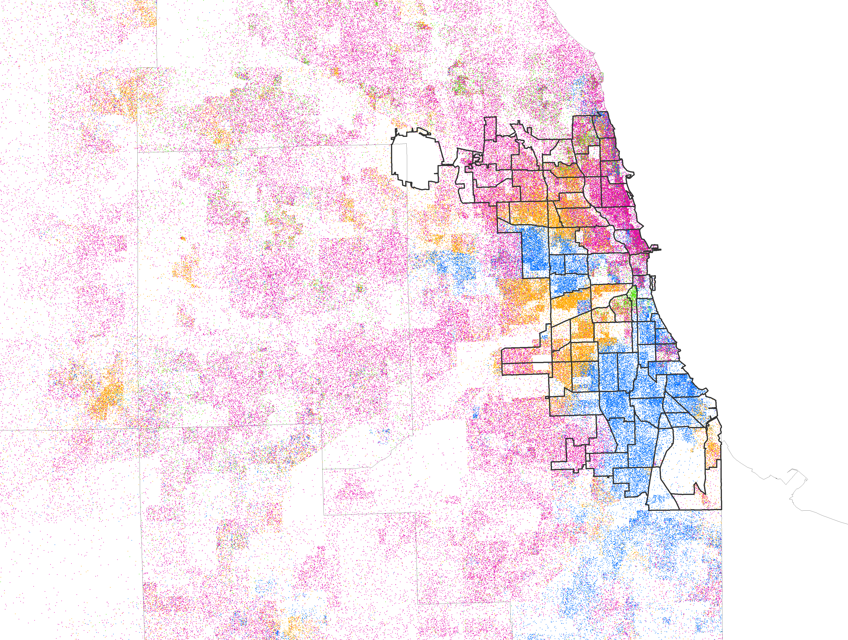
Racial/Ethnic Change in City of Chicago during the 2000s
Distribution of Metro Chicago racial/ethnic groups:
Whites
Blacks
Asians
Latinos
Segregation Defines the Hyper-Segregated Chicago Region
Each dot=25 people

Slide 5
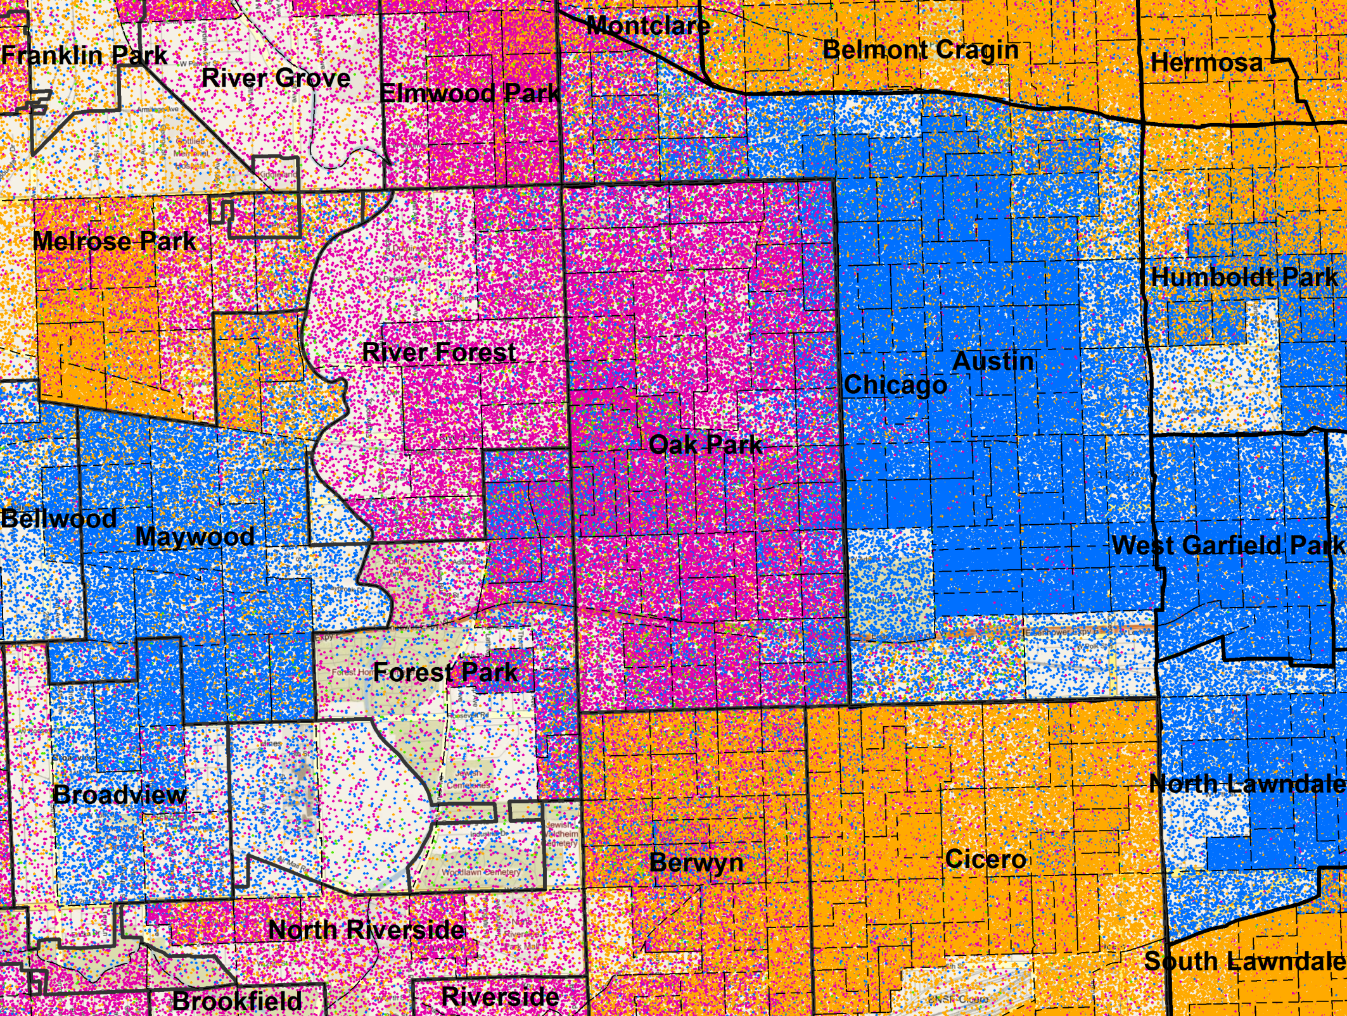
Census block groups
Each dot=1 person
Each Dot = 1 Person

Slide 6
2010 Census Changes

Slide 7
2010 Census Changes

Slide 8
2010 Census Changes

Slide 9
2010 Census Changes

Slide 10
Ensuring a Diverse Future We MUST Be INTENTIONAL
Human progress is neither automatic nor inevitable. Every step toward the goal of justice requires the tireless exertions and passionate concern of dedicated individuals.
- Martin Luther King, Jr.
The future depends on what we do in the present.
- Mohandas K. Gandhi

Slide 11
2010 Census Changes

Slide 13
Ensuring a Diverse Future
But, we live in a post-racial society! Right?
I mean we elected a black president!

Slide 14
Ensuring a Diverse Future
The Housing Market is Dynamic – about 1/3 of all people move every year
Segregation Continues to Dominate the Region – including in most neighboring communities
Implicit Association and “Blind Spots” Negatively Impact Housing Choices – most are unaware of opportunities in under-represented communities
The Next Generation is NOT Post-Racial – research refutes “conventional wisdom”

Slide 15
Ensuring a Diverse Future
Diversity and Integration are NOT Guaranteed
Whites are particularly reluctant to move to diverse communities.
Less than 50% would move to a neighborhood that is 1/3 black.
Less than 30% would move to a neighborhood that is majority black.
Regardless of percentages, whites rarely move to a community that has a greater percentage of African Americans than is present in their current neighborhood.
Other minority populations frequently follow white attitudes regarding African American neighborhoods.
Housing Center evidence continues to confirm these findings as initial perceptions of Oak Park.

Slide 16
Ensuring a Diverse Future
Implicit Association
Internalized, subconscious bias
Over 100 academic studies
All show implicit bias favoring whites
All confirm racial stereotypes
This does not mean you’re a bad person!
Check your implicit bias at:
https://implicit.harvard.edu/implicit/demo/

Slide 17
Diversity and Beyond
Opportunity – the benefit
Diversity – the foundation
Integration – the structure
Inclusion – the realization

Slide 18
Diversity and Beyond
There is Still Plenty of Work
Does the community reflect regional diversity? Do people of all races want to live here?
Is this diversity integrated? Do people live among each other?
Is the community providing equal opportunity to all? Are their opportunity gaps?
Does the community foster inclusion from all? Do leadership positions reflect the diversity of the community? Do all groups engage in civic and social participation?

Slide 19
Living Our Aspirations
How Do We Ensure a Diverse Future?
HUD Study found a need for “institutional structures to sustain diversity” and “active intervention to combat misconceptions”
Leading Scholar, Dennis Keating: “To achieve the goal of community integration, affirmative housing policies are required”
In 2004, McKenzie and Ruby found:
White people are reluctant to rent in neighborhoods where there are a significant number of black tenants. If Oak Park is to continue to realize its goal of dispersed integration then the Housing Center will have to continue to induce white demand in East Oak Park.

Slide 20
Living Our Aspirations
The Housing Center Model
Provide Rental Referrals
Provide Technical Assistance and Listings for Property Owners
Advocate in the Community
Institutions
Individuals
Encourage Outside Participation

Slide 21
Living Our Aspirations
We CANNOT Do It Alone
We need YOU to be involved.
Volunteer
Tell a Friend & Spread the Word
List your Rental Unit
Donate

